Slide 1
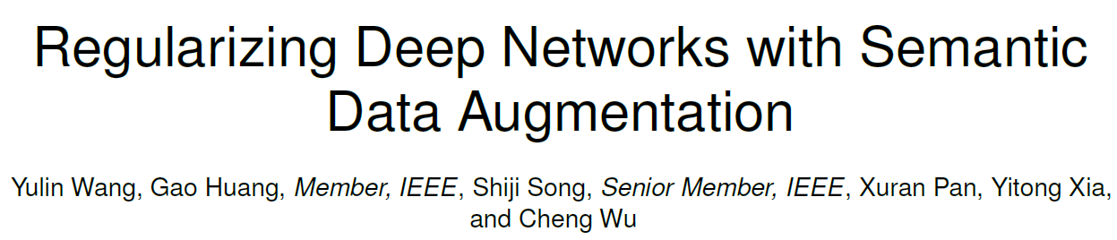
Jeonbuk National University, Korea
Multimedia Lab Under Prof. Park and Prof. Yoon
Mingle Xu
2021, Nov, 26

Slide 2
Outlines
Related works
Feature representation and deep learning
Data augmentation method
Sampling and learning
Abstract
Method
Experiments
Conclusion

Slide 3
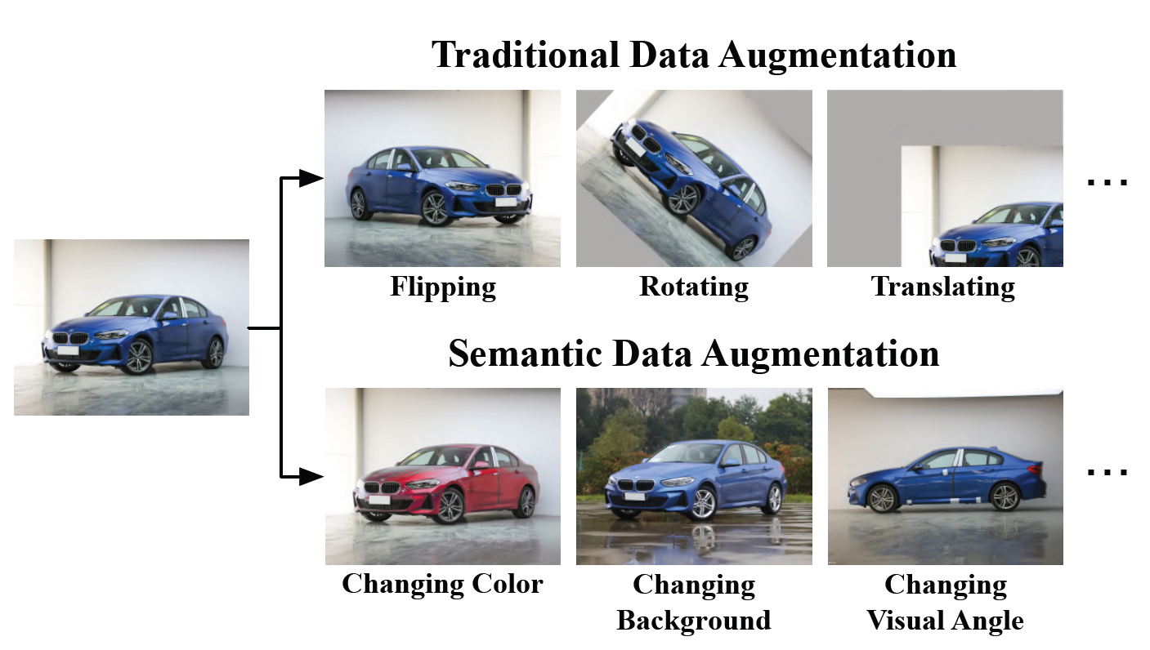
Introduction

Slide 4
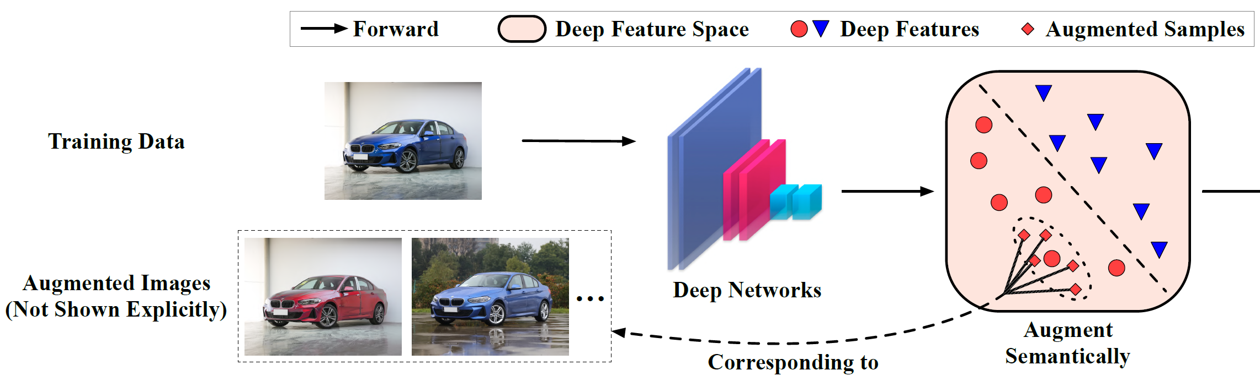
Introduction
Observation: the feature learned by deep learning method is linearized.

Slide 5
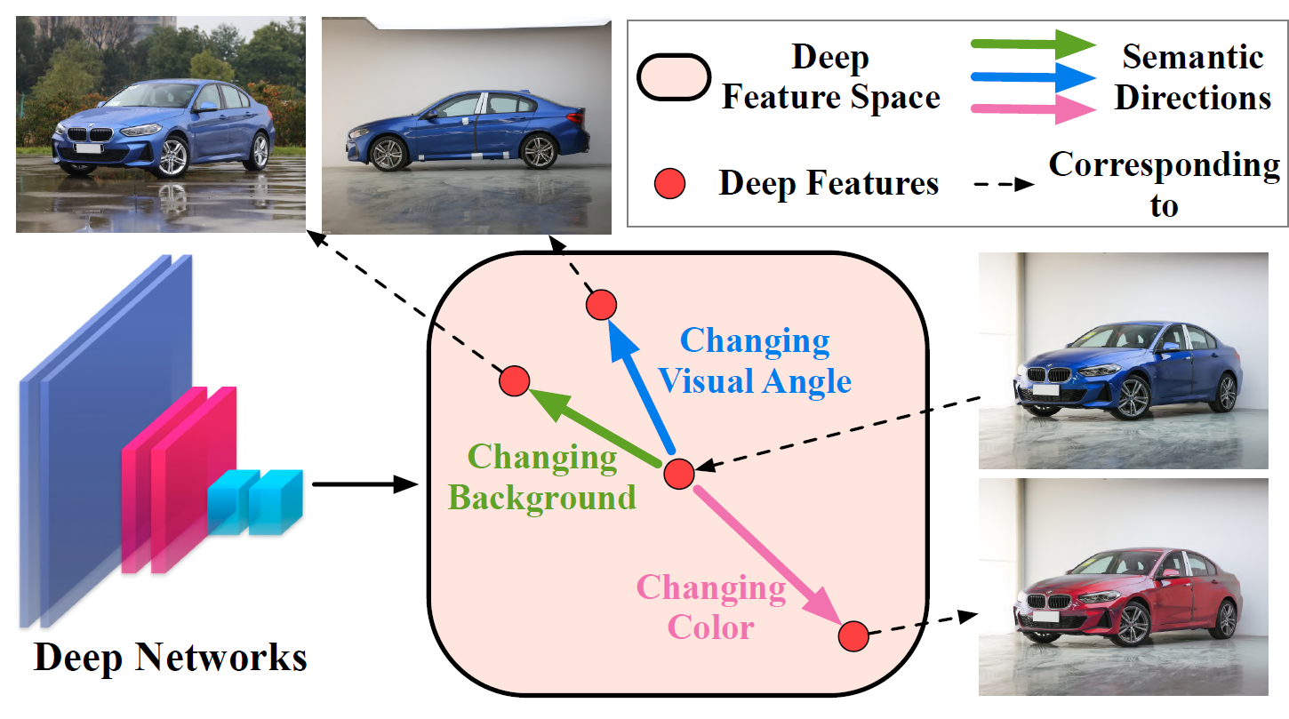
Introduction
How to sample: how to know the direction?

Slide 6
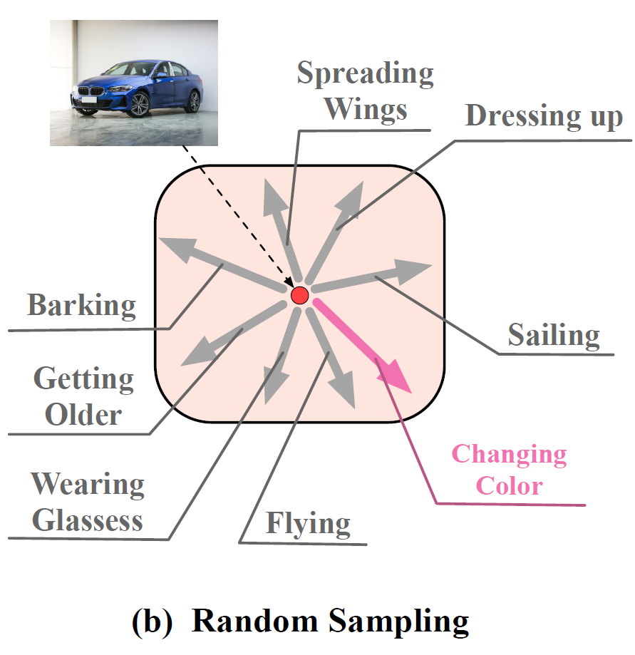
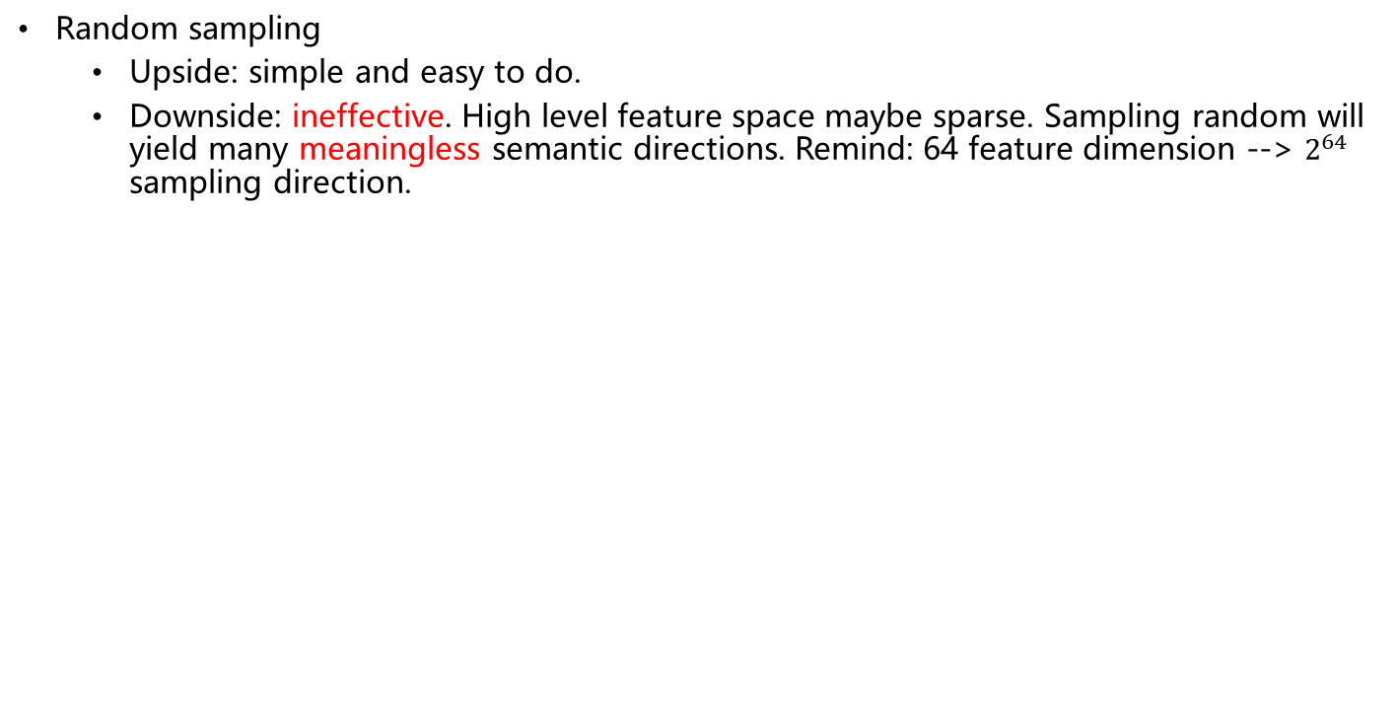
Related Work: Semantic Directions Sampling
Random sampling
Upside: simple and easy to do.
Downside: ineffective. High level feature space maybe sparse. Sampling random will yield many meaningless semantic directions. Remind: 64 feature dimension --> $2^{64}$ sampling direction.

Slide 7
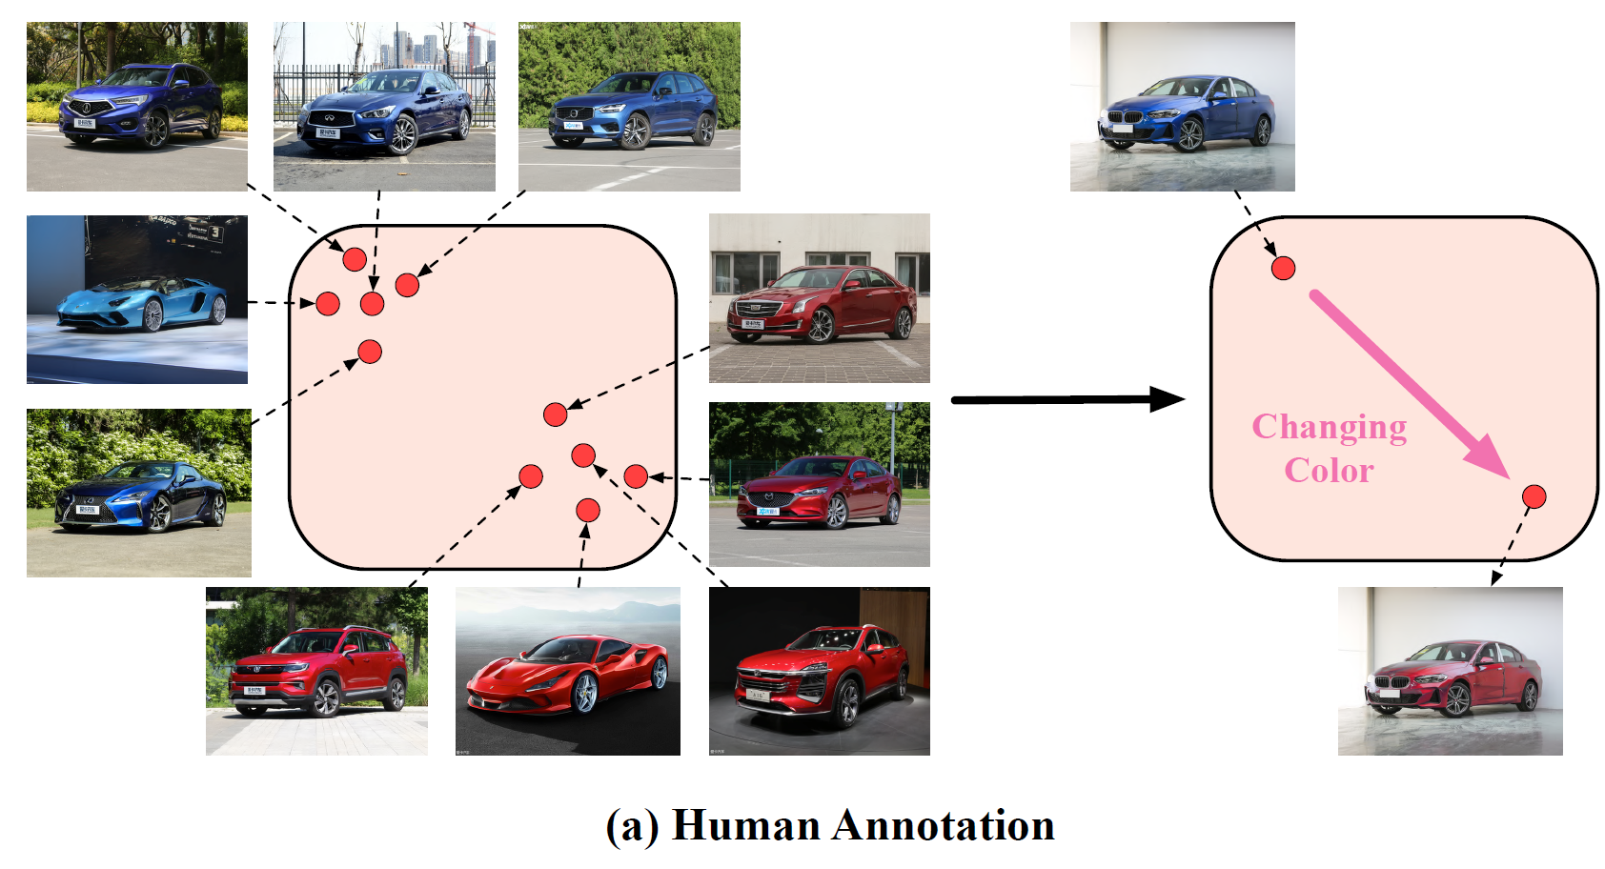
Related Work: Semantic Directions Sampling
Human annotation: annotate and average.
Upside: effective.
Downside: inefficient, need annotation, can not label all directions in advance.
Blue to red.

Slide 8
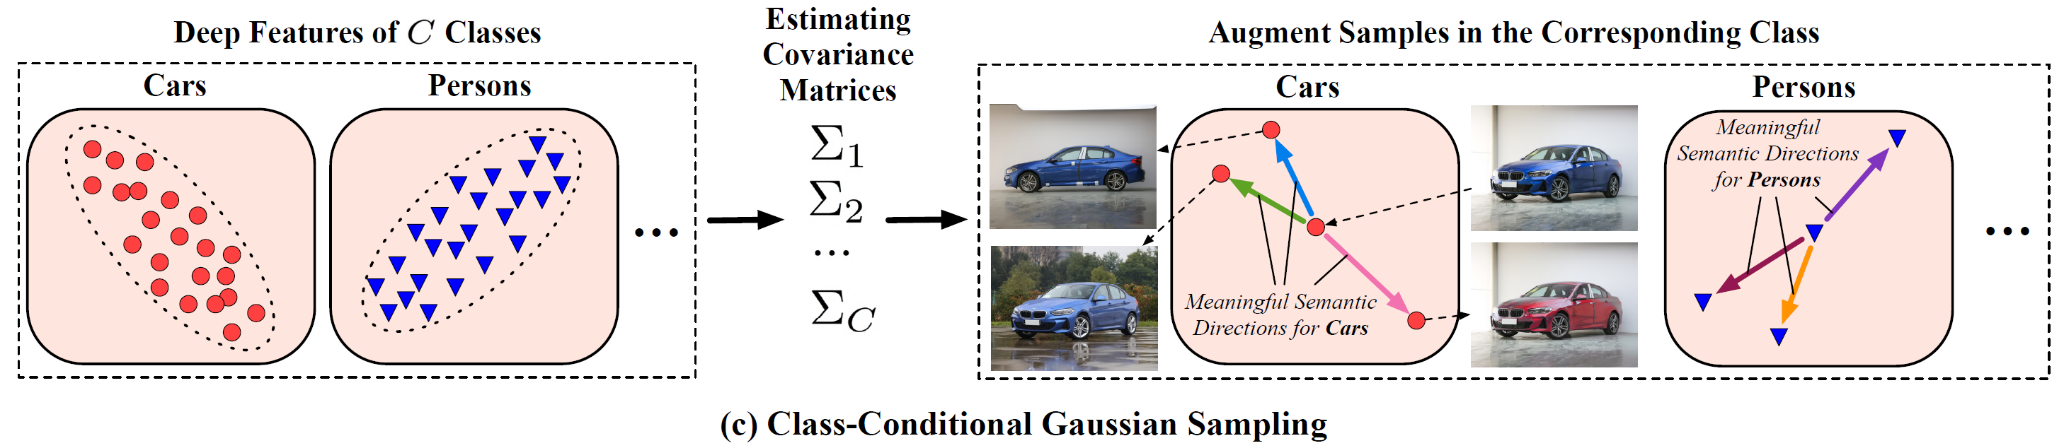
Proposed Algorithm: ISDA
Implicit semantic data augmentation
Sampling random vectors from a normal distribution with a covariance which is proportional to the intra-class covariance matrix of samples to be augmented.
The covariance matrix captures the variance of samples in that class and is likely to contain rich semantic information.
Upside:
Efficient: label-agnostic, automatic learn the semantic info
Person: wearing glasses, do not need annotation.
Plane: having propeller

Slide 9
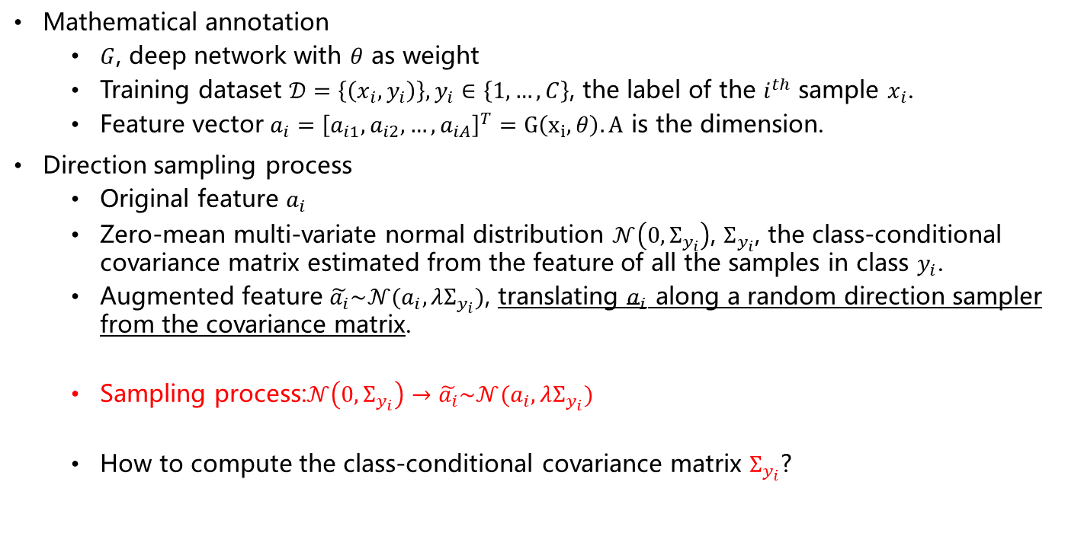
Proposed Algorithm: ISDA
Mathematical annotation
$G$, deep network with $θ$ as weight
Training dataset $𝒟=\left\{\left(x_{i},y_{i}\right)\right\}, y_{i}∈\left\{1,…,C\right\}$, the label of the $i^{th}$ sample $x_{i}$.
Feature vector $a_{i}={\left[a_{i1},a_{i2},…,a_{iA}\right]}^{T}=G\left(x_{i},θ\right). A$ is the dimension.
Direction sampling process
Original feature $a_{i}$
Zero-mean multi-variate normal distribution $𝒩\left(0,Σ_{y_{i}}\right)$, $Σ_{y_{i}}$, the class-conditional covariance matrix estimated from the feature of all the samples in class $y_{i}$.
Augmented feature $\tilde{a_{i}}\sim 𝒩(a_{i}, λΣ_{y_{i}})$, translating $a_{i}$ along a random direction sampler from the covariance matrix.
Sampling process:$𝒩\left(0,Σ_{y_{i}}\right)→\tilde{a_{i}}\sim 𝒩(a_{i}, λΣ_{y_{i}})$
How to compute the class-conditional covariance matrix $Σ_{y_{i}}$?

Slide 10
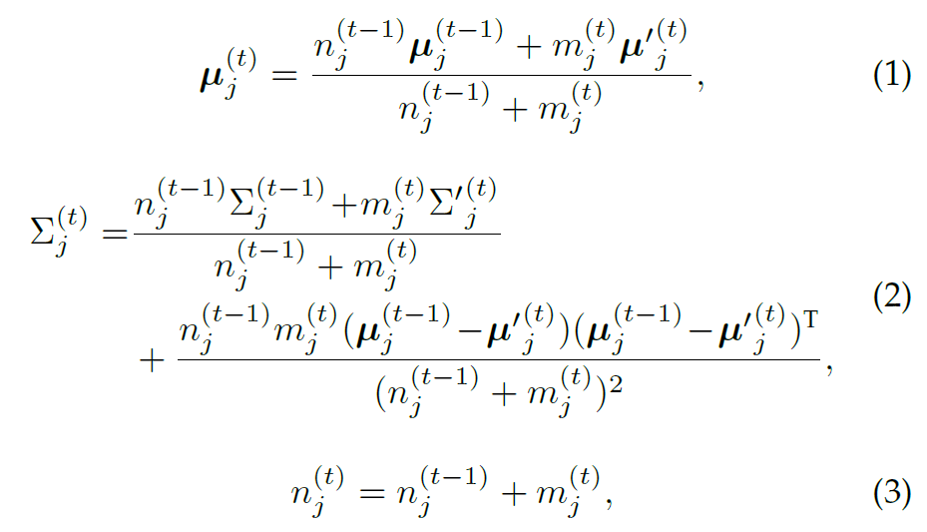
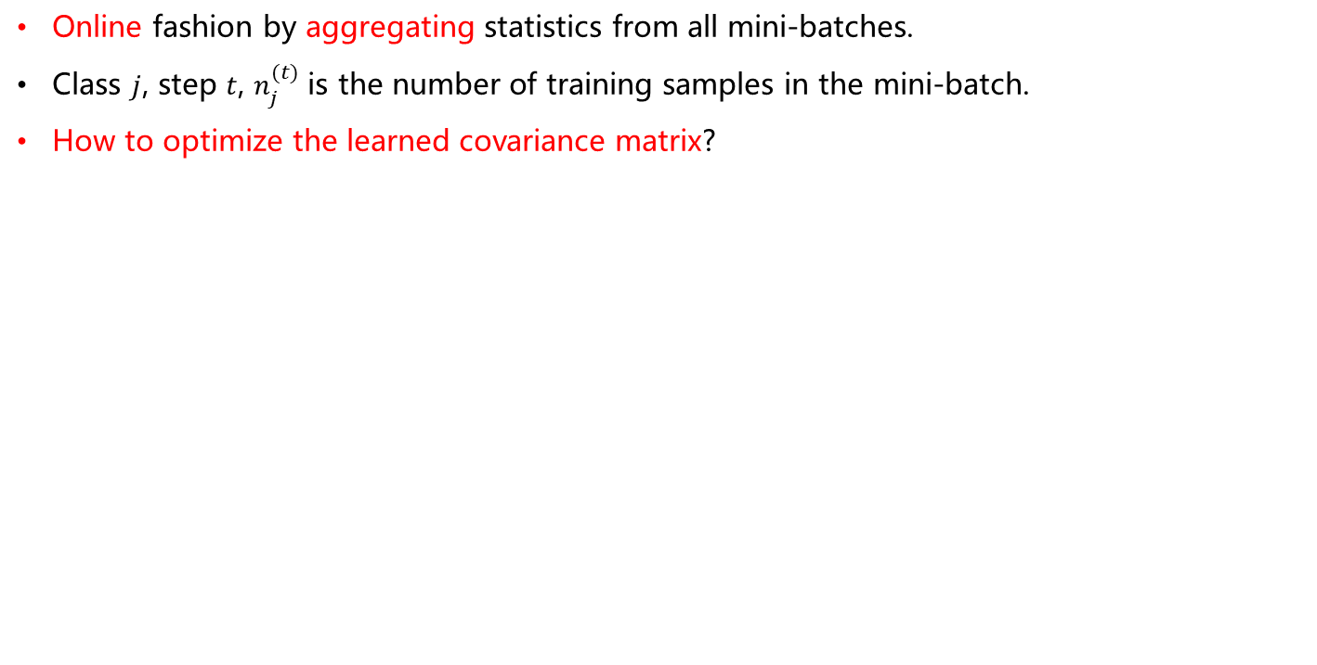
Proposed Algorithm: ISDA
Online fashion by aggregating statistics from all mini-batches.
Class $j$, step $t$, $n_{j}^{(t)}$ is the number of training samples in the mini-batch.
How to optimize the learned covariance matrix?

Slide 11
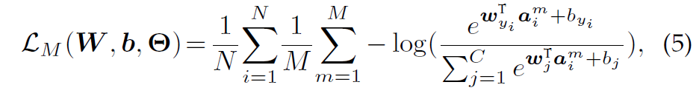
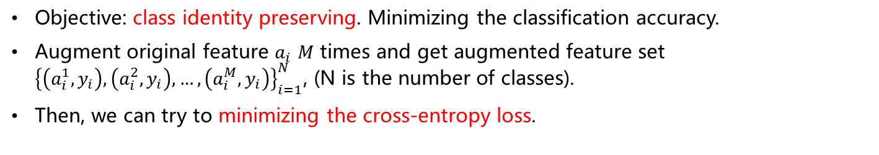
Proposed Algorithm: ISDA
Objective: class identity preserving. Minimizing the classification accuracy.
Augment original feature $a_{i}$ $M$ times and get augmented feature set ${\left\{\left(a_{i}^{1},y_{i}\right),\left(a_{i}^{2},y_{i}\right),…,\left(a_{i}^{M},y_{i}\right)\right\}}_{i=1}^{N}$, (N is the number of classes).
Then, we can try to minimizing the cross-entropy loss.
Two optimization method
Naïve method with SGD by sampling different values, and we hope M is very large and then we can get approximate covariance matrix.
Optimize the upper bound. This is the implicit.

Slide 12
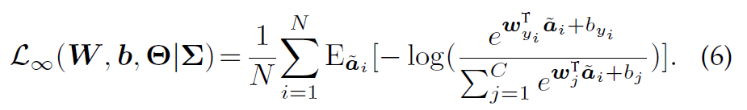
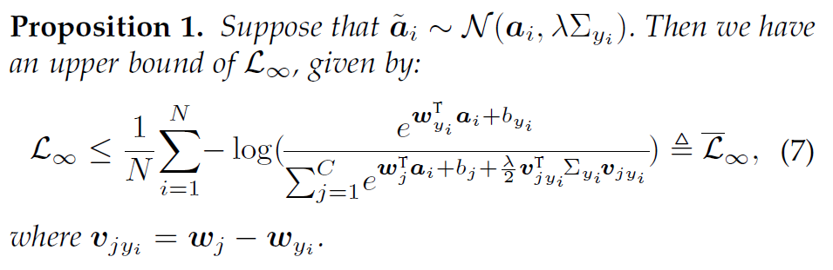
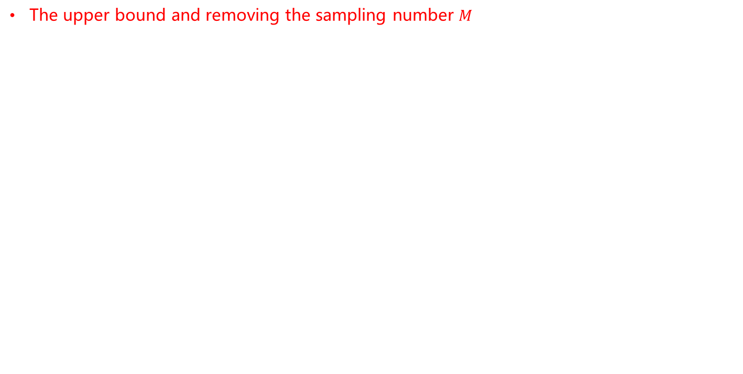
Proposed Algorithm: ISDA
The upper bound and removing the sampling number $M$

Slide 13
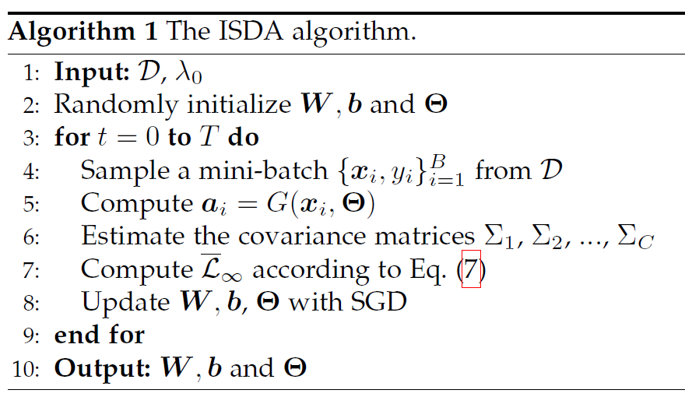
The proposed algorithm

Slide 14
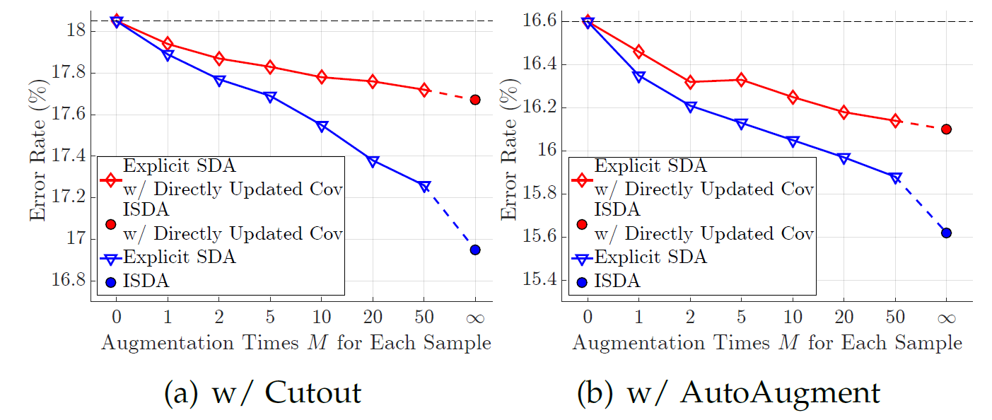
Naïve or upper bound

Slide 15
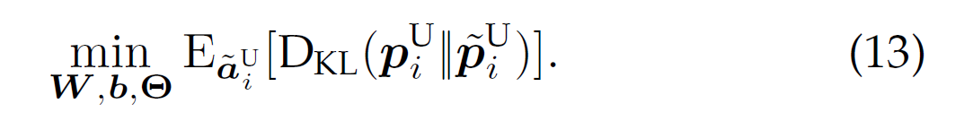
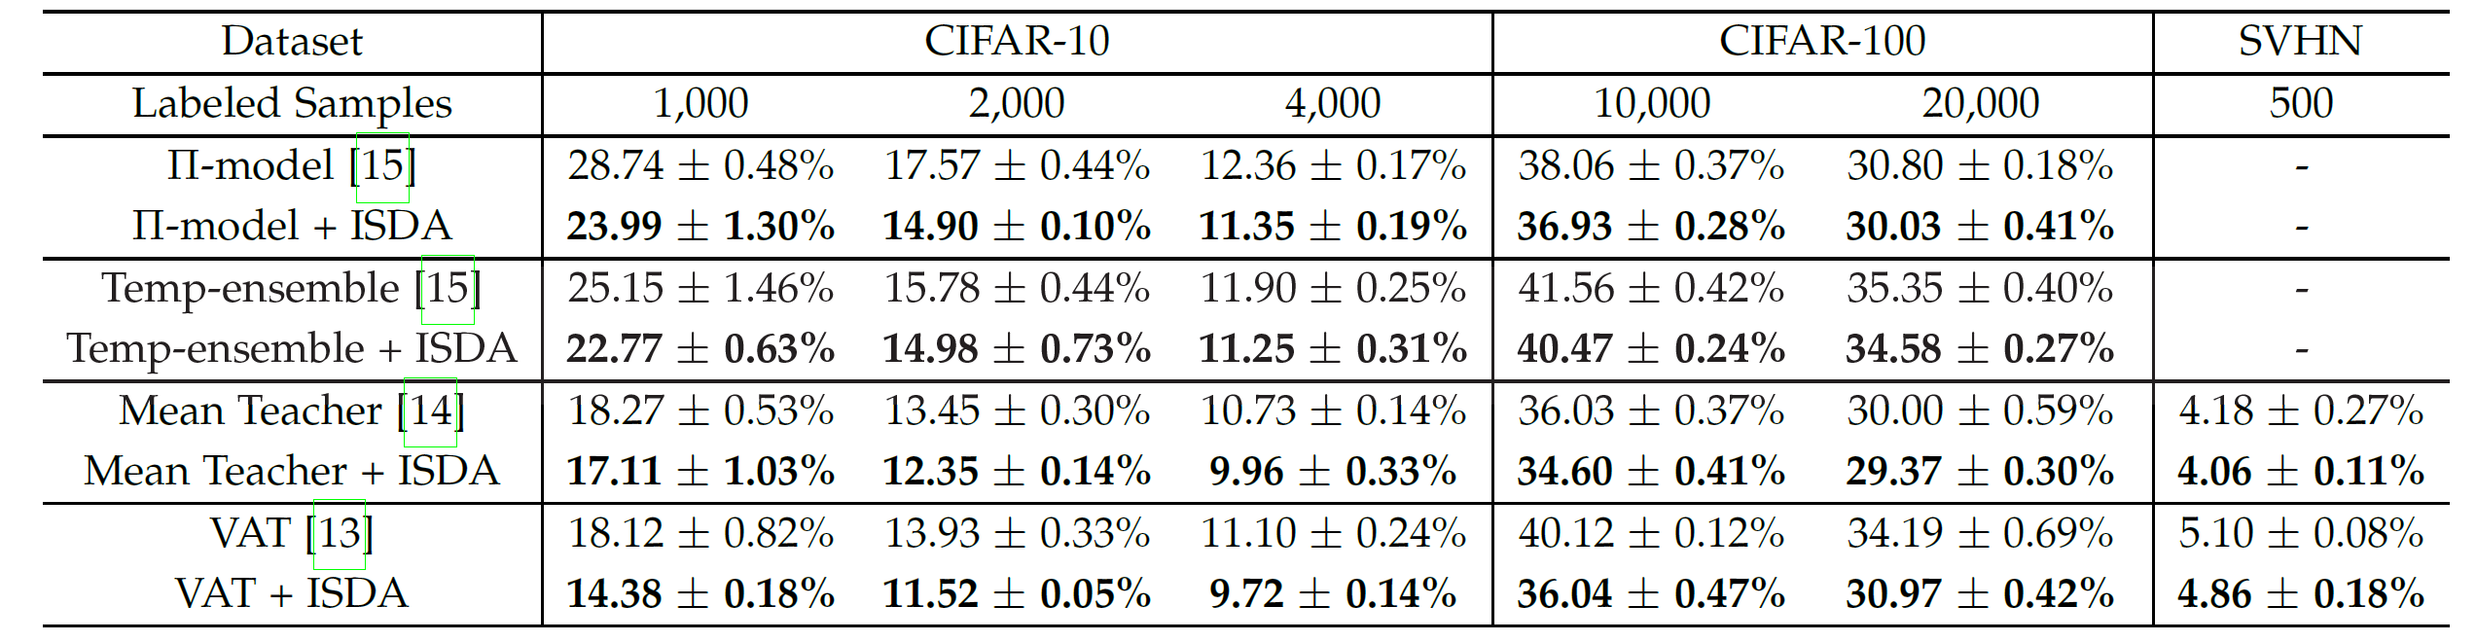
ISDA for semi-supervised learning
Augment the deep features of unlabeled data.
Minimize the KL-divergence between the predictions of the augmented samples and the corresponding original samples.

Slide 16
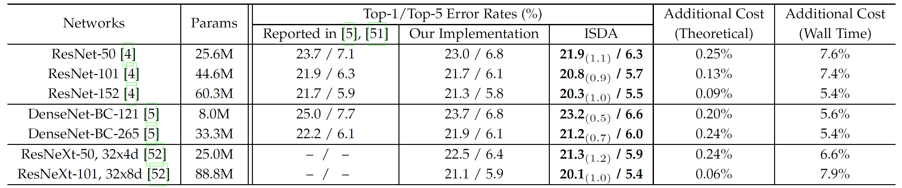
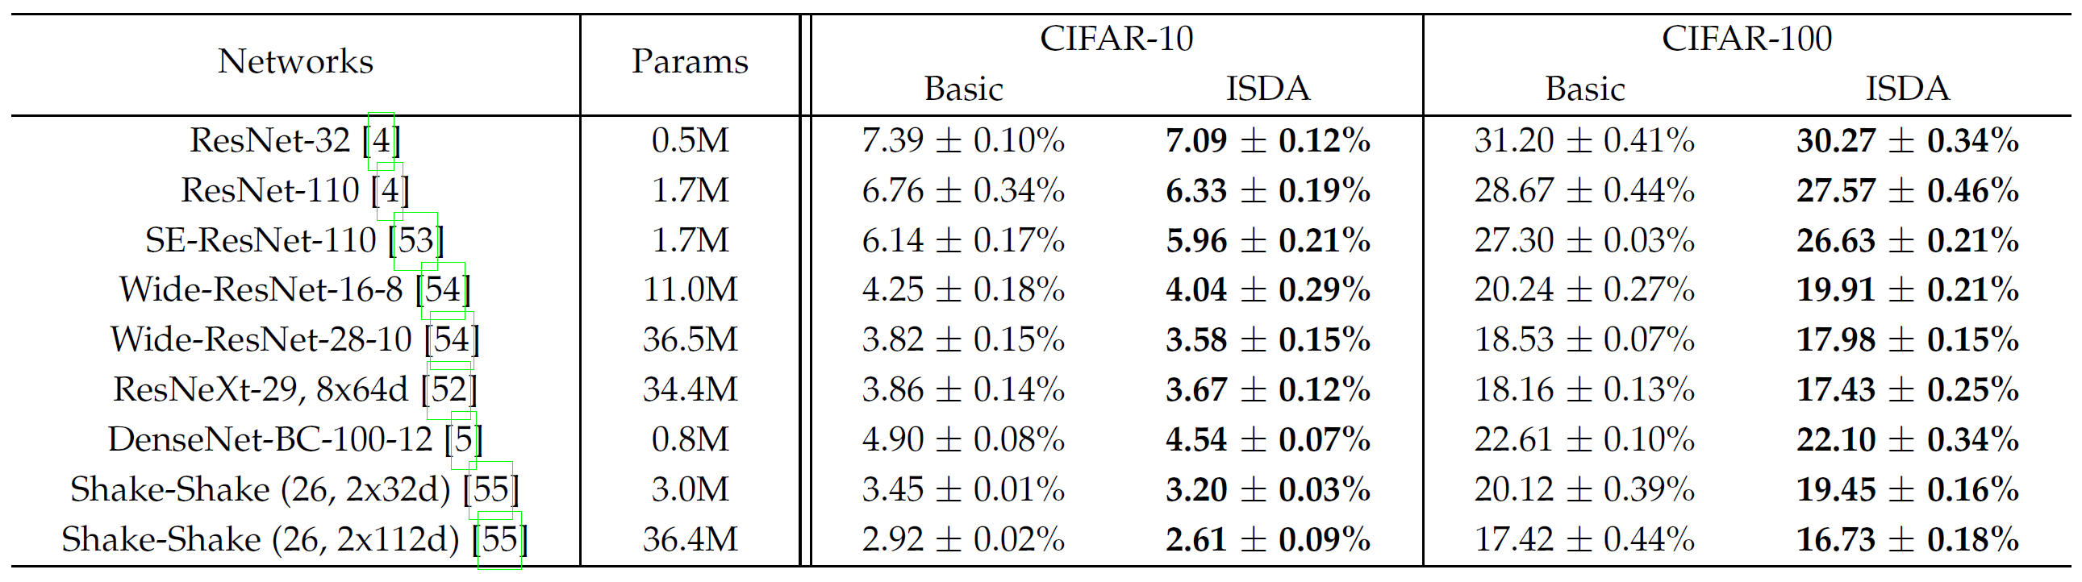
Experiments
On ImageNet and others.

Slide 17
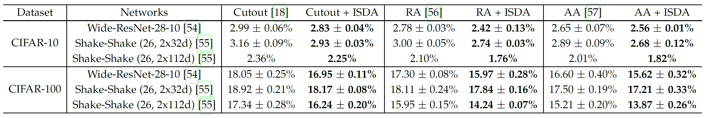
With state-of-the-art non-semantic augmentation.

Slide 18
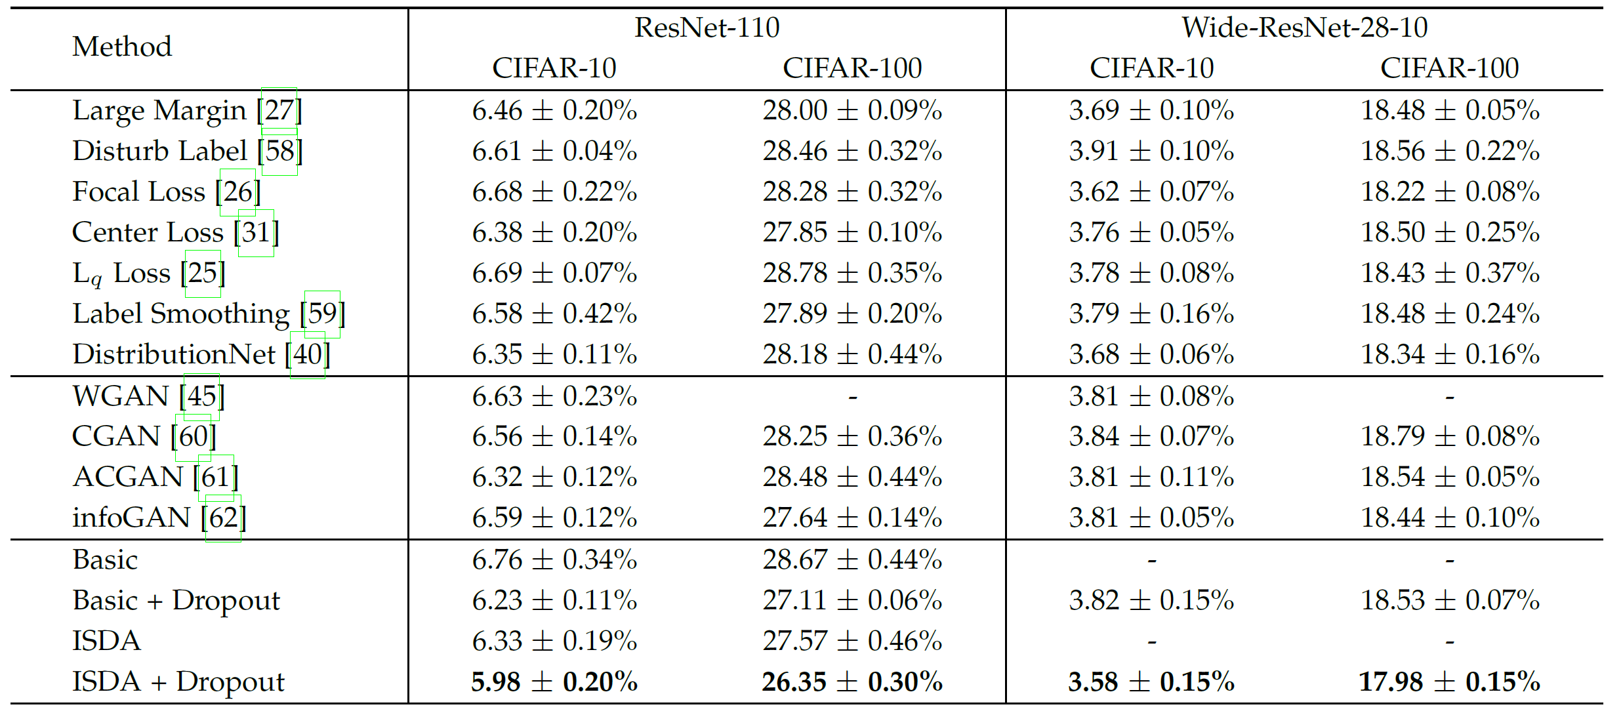
Comparison

Slide 19
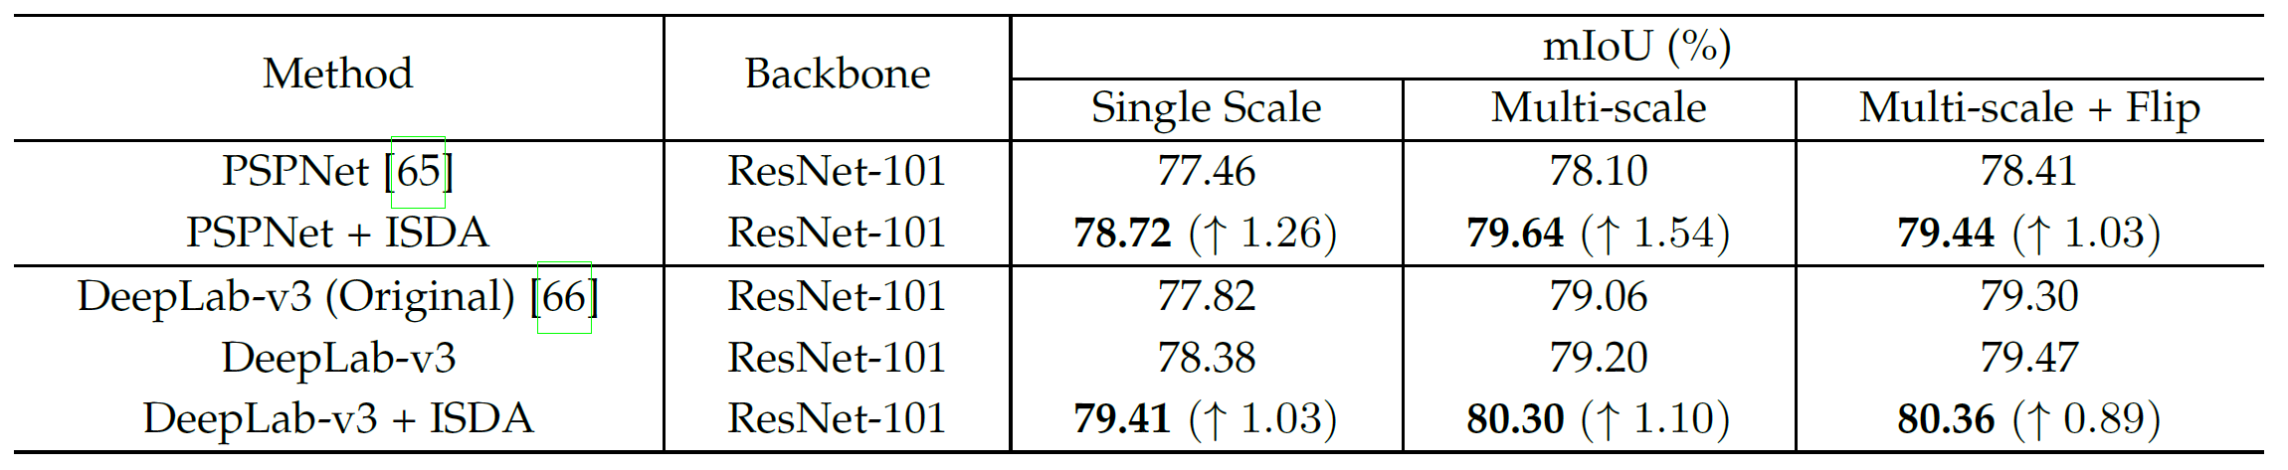
Semantic segmentation

Slide 20
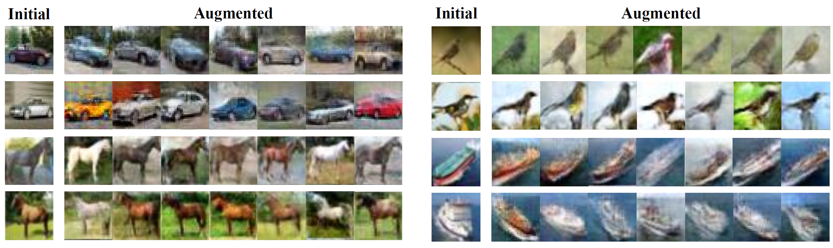
Visualize the augmented feature

Slide 21
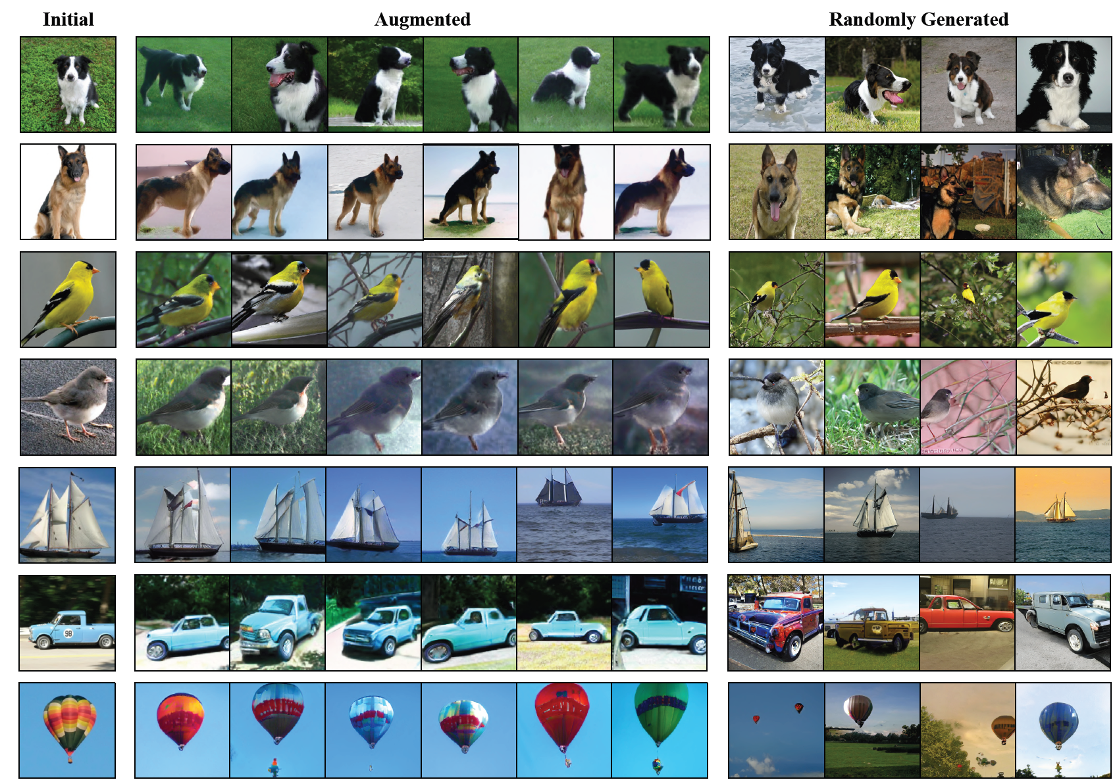

Slide 22
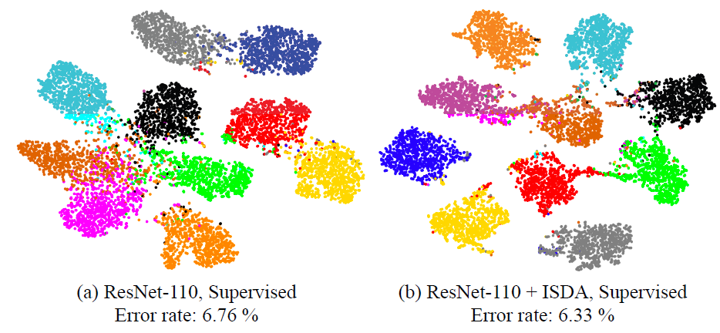

Slide 23
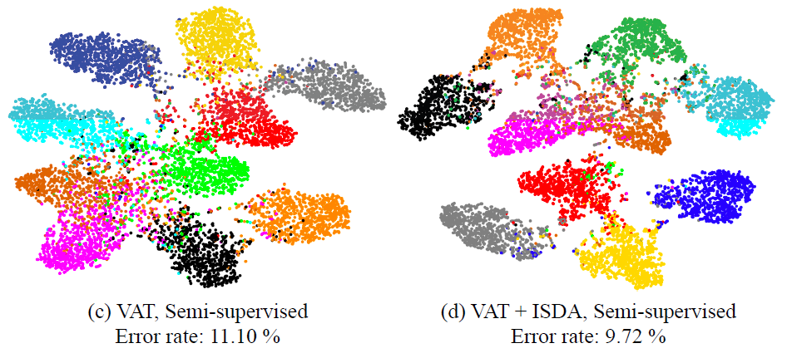

Slide 24
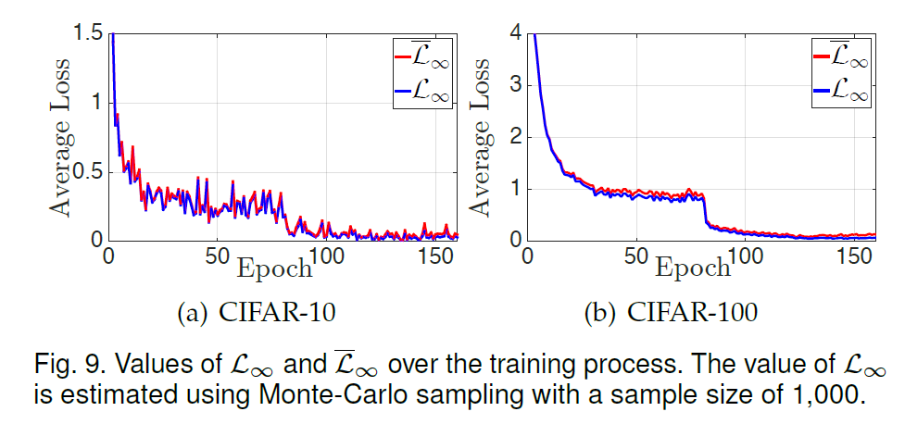
About the upper bound

Slide 25
Conclusion
Observation: the feature learned by deep learning method is linearized.
How to sample: from a covariance matrix
How to optimize the matrix: upper bound
Sematic data augmentation
Robust
Efficient, no many extra computation to train
With semi-supervised learning.

Slide 26
Comments
The basic assumption behind the paper? In-class data augmentation.
There is a big variation in the training dataset for one specific class.
If there is no blue car in the dataset, then we can not produce blue car by this data augmentation.
Such as our tomato dataset, one class do not have one kind of illumination or type of tomato.
Therefore, the semantic data augmentation in this paper is for in-domain task.
But I admitted that this paper is well motivated.

